Slide 1
Heart Attack Risk ML Models
Group 3
Austin Mccormick
Mareme anne
Kashif zafar
Mike Bollinger

Slide 2
Background and Goals
Background
Cardiovascular diseases remain a leading cause of mortality, making early risk prediction critical.
The analysis uses a dataset with known heart attack risk values, including features like age, cholesterol, blood pressure, and lifestyle factors.
Four machine learning approaches were applied:
Unsupervised: K-means for clustering patterns and PCA for dimensionality reduction.
Supervised: Logistic Regression for interpretable classification and Random Forest for robust, ensemble-based predictions.

Slide 3
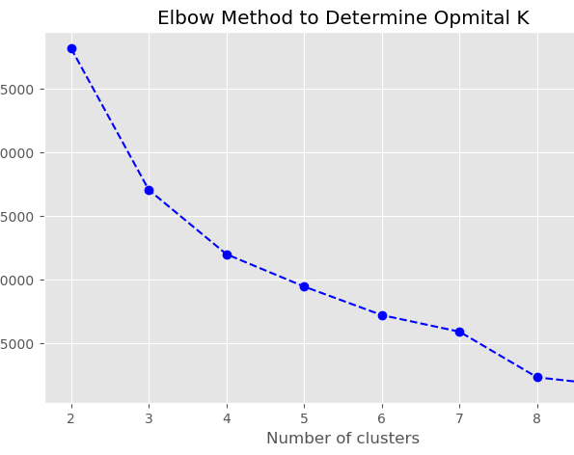
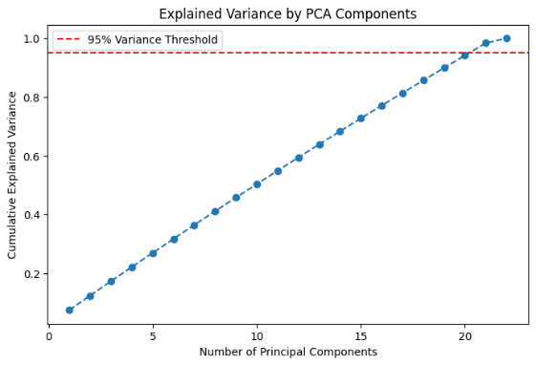
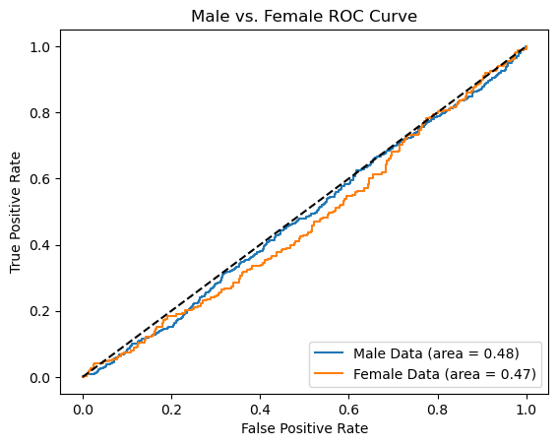
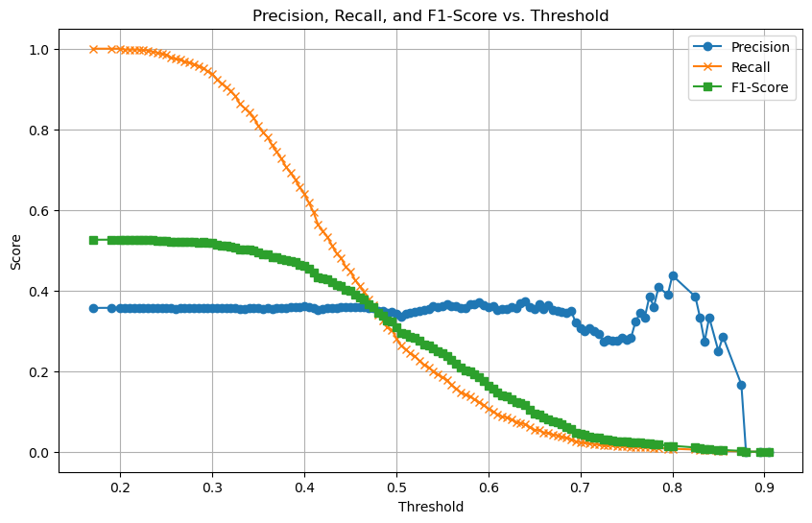
Content Overview
Unsupervised ML
Supervised ML
1. K – Means
2. PCA(Principal Component Analysis)
3. Logistic Regression
4. Random Forest
Cluster sizes:
- Cluster 0: 904 patients
- Cluster 1: 2,513 patients
- Cluster 2: 2,614 patients
- Cluster 3: 2,732 patients
Clusters categorized individuals based on shared characteristics, without reflecting risk levels.
ANOVA findings: No notable differences in heart attack risk across clusters (p-value = 0.647).
Conclusion: K-Means clustering proved ineffective in pinpointing high-risk groups.
Def: Principal Component Analysis (PCA) is a dimensionality reduction technique that transforms high-dimensional data into a smaller set of uncorrelated features (principal components) while retaining the most important information.“
Def: Logistic Regression is a statistical model used for binary or multi-class classification, predicting the probability of an outcome based on input features.
Def: Random Forest is an ensemble machine learning algorithm that combines multiple decision trees to make robust predictions, improving accuracy and reducing overfitting.
USED :
Removes redundant information.
Helps with visualization in 2D/3D.
Improves efficiency of ML models.
USED :
Effective for linearly separable data
Provides interpretable coefficients to understand feature influence
Works well with smaller datasets and is computationally efficient
USED :
Handles both classification and regression tasks effectively.
Reduces overfitting compared to a single decision tree.
Provides insights into feature importance for better interpretability.

Slide 4
K Means Clustering

Slide 5
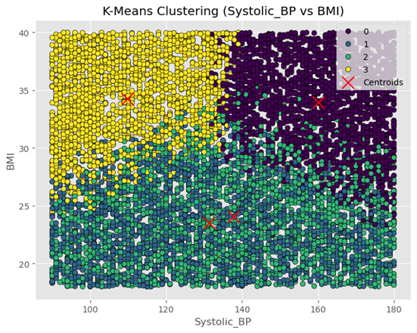
Background and Goals
1. Unsupervised Learning Approach (K-Means Clustering)
Implemented K-Means Clustering to classify patients into risk groups based on their characteristics.
Utilised the Elbow Method to find the ideal number of clusters (K = 4).
Clustering considered factors like Systolic BP, BMI, Cholesterol, Age, Exercise Hours, and Smoking.
Silhouette Scores for various feature combinations:
(Systolic BP, BMI, Cholesterol): 0.2668
(Age, Heart Rate, Exercise Hours): 0.2651
(Diabetes, Smoking, Systolic BP, Obesity): 0.4367

Slide 6
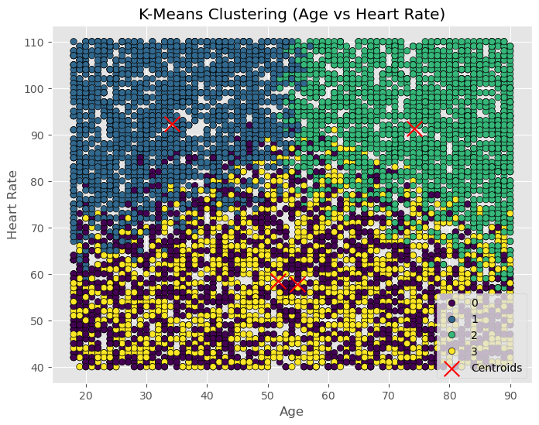
Machine Learning Method #: Unsupervised Learning (K-Means Clustering)
🔹 Goal: To group patients into clusters based on similarities in health features without prior knowledge of heart attack risk.
🔹 Expectation: Clusters would reveal distinct risk groups based on shared health characteristics.
🔹 Outcome: Clustering did not effectively differentiate risk levels because the data was already labeled, making unsupervised learning unsuitable.
✅ Unsupervised learning (K-Means) is ineffective for risk assessment because clusters do not align with actual heart attack risk.
✅ Supervised learning (Random Forest) is better as it provides predictive insights based on labeled data.
✅ Classification models should be used for risk prediction instead of clustering.
✅ Future work: Test Logistic Regression, Neural Networks, or XGBoost for improved accuracy.
What is the takeaway from this slide?

Slide 7
PCA

Slide 8
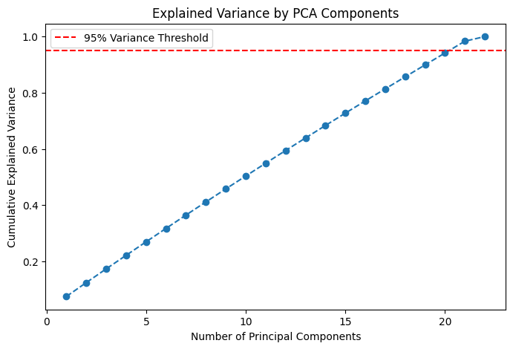
Machine Learning Method #: Unsupervised ML
Data/Visual/Table
Purpose/ Goal of this method
This plot shows how much variance each principal component retains.
The red dashed line represents the 95% variance threshold.
Key findings
We need around 20 components to retain 95% of the variance.
Using only 2-3 components results in loss of information.
PCA helps reduce dimensions but keeping too few can discard important data.
* We should choose the optimal number of components based on explained variance.

Slide 9
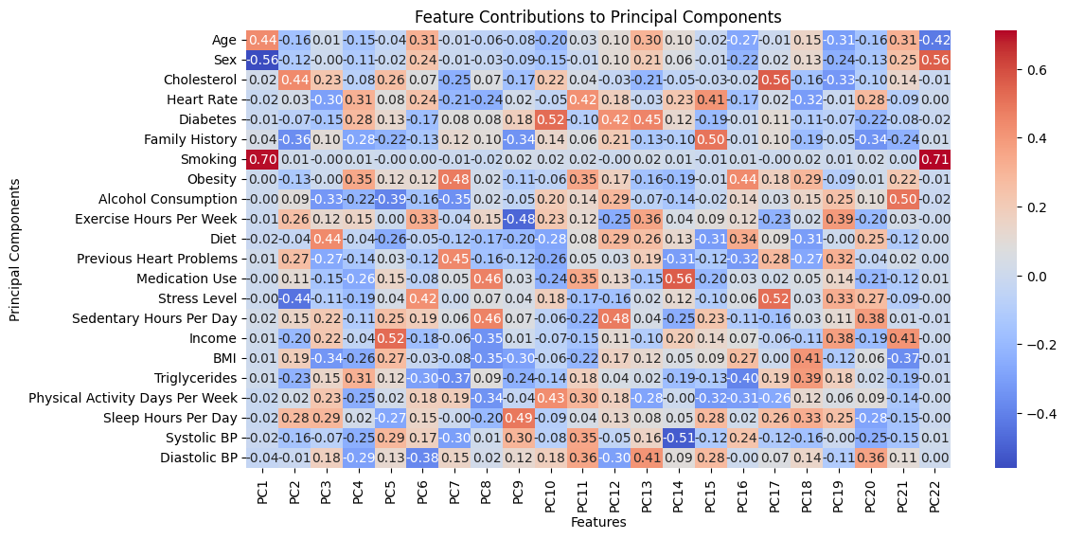
Machine Learning Method #: Unsupervised ML
Data/Visual/Table
Purpose/ Goal of this method
Identify which features influence PCA the most.
Understand how different health factors relate to new principal components.
Key findings
PC1 is highly influenced by Smoking, Age and Sex
Cholesterol has little impact on PC1 but contributes more to other PCs.
PC1 seems to capture lifestyle-related factors (Smoking, Sex, age, etc.).
What is the takeaway from this slide? * PCA groups related features into new dimensions.
* Understanding these contributions helps in feature selection.

Slide 10
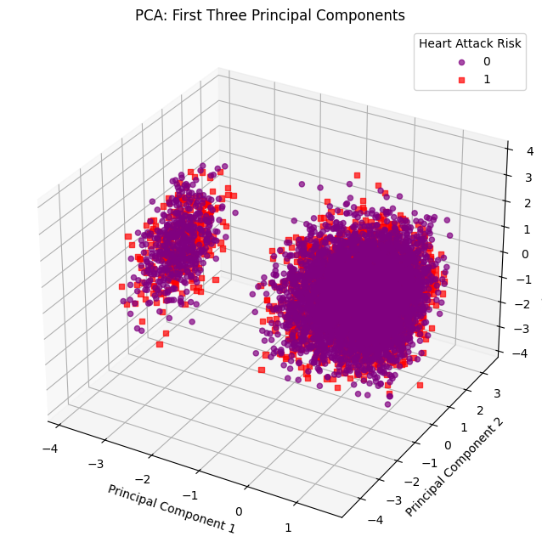
Machine Learning Method #: Unsupervised ML
Data/Visual/Table
Purpose/ Goal of this method
This plot shows the data projected onto three principal components (PC1, PC2, PC3).
Helps visualize data structure and potential risk clusters.
Key findings
Adding a third component improves data separation, revealing clearer clusters.
Some overlap between high-risk (🔴) and low-risk (🟣) individuals remains.
Outliers suggest extreme-risk cases that need further investigation.
Adding PC3 improves separation, but some overlap remains. * Clusters suggest distinct patient groups, which may relate to heart attack risk. *Outliers exist, highlighting individuals with unusual risk factors.

Slide 11
Logistic Regression

Slide 12
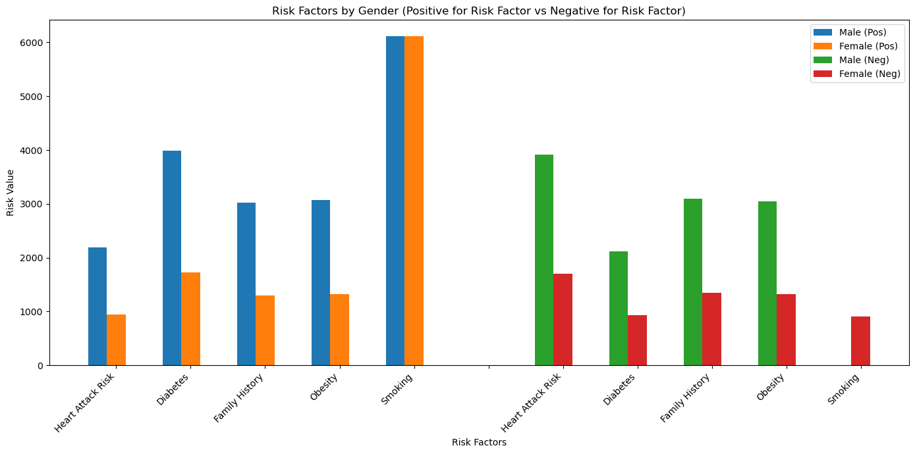
Logistical Regression: Supervised Learning
Data/Visual/Table
Purpose/ Goal of this method
Analysis of the data indicates a strong correlation between smoking and elevated heart attack risk.
Adopting a healthier lifestyle appears to be a significant factor in mitigating the risk of heart attack.
Comparative analysis suggests that men exhibiting unhealthy lifestyle choices may face a disproportionately higher risk of heart attack compared to women with similar habits.
Key findings
The accompanying graphical representation illustrates participant responses concerning identified risk factors.
The left panel of the graph depicts data from participants who indicated the presence of at least one of the specified risk factors.
Conversely, the right panel presents data from participants who reported the absence of all assessed risk factors.
The graph shows how participants responded to questions about risk factors. The left side shows those who said "yes" to at least one risk factor, while the right side shows those who said "no" to all risk factors.

Slide 13
Logistical Regression: Supervised Learning
Data/Visual/Table
Purpose/ Goal of this method
This visualization projects the data as a Receiver Operating Characteristic (ROC) curve.
The graph illustrates the true positive rates against the false positive rates for both male and female datasets.
Key findings
The Logistic Regression model appears to exhibit limited understanding of the provided data. Furthermore, the resulting graphical output demonstrates variability across multiple iterations of the model execution.

Slide 14
Random Forest

Slide 15
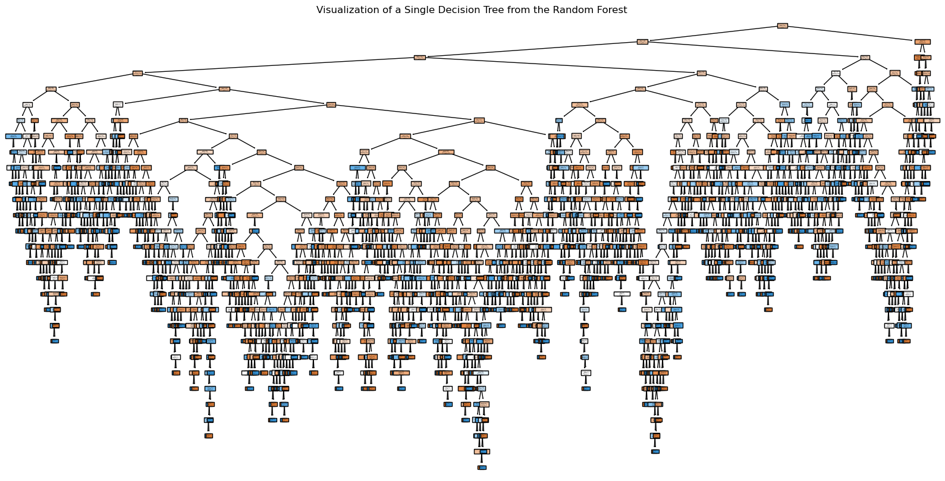
Machine Learning Method #: Random Forest
Visualization of a single decision tree
Data/Visual/Table
Purpose: Random Forest builds a reliable prediction model by combining multiple decision trees to improve accuracy and reduce overfitting.
Key findings
The target class (Heart Attack Risk) is imbalanced, with more instances of one class (e.g., "no heart attack risk") than the other (e.g., "at risk").
Model performance: ~64%. Primarily predicted majority class (no risk)
After SMOTE: ~55%. Minority class prediction improved, but precision dropped
Model Visualization Viewpoints
Large decision tree- shows complexity of dataset
Low level of interpretability based on high number of decisions
Random forest resulted in a model performance of 64% (target 75%)

Slide 16
Machine Learning Method #: Random Forest
Precision, Recall, and F1-Score vs Threshold
Purpose: Decision threshold analysis involves adjusting the threshold used by a machine learning model to classify predictions into different categories.
Key findings
- Lower thresholds, such as 0.10 and 0.20, achieve perfect recall but result in low precision, leading to many false positives.
- As the threshold increases, recall decreases significantly, while precision shows slight improvement, highlighting a trade-off.
- F1-Score is highest at lower thresholds, indicating that a recall-focused approach is optimal for this dataset.
Visualization Viewpoints
There is a tradeoff between precision and recall as it relates to the F1 score.
Increasing the threshold allows for optimization of model precision, recall, and F1-score
After further model optimization (SMOTE/Decision threshold analysis) a higher F1 score could not be achieved

Slide 17
Summary
Unsupervised ML
Supervised ML
1. K – Means
2. PCA(Principal Component Analysis)
3. Logistic Regression
4. Random Forest
Key Findings
Unsupervised learning (K-Means) is ineffective for risk assessment because clusters do not align with actual heart attack risk.
Supervised learning (Random Forest) is better as it provides predictive insights based on labeled data.
Classification models should be used for risk prediction instead of clustering.
Future work: Test Logistic Regression, Neural Networks, or XGBoost for improved accuracy.
Key Findings
We need around 20 components to retain 95% of the variance.
Using only 2-3 components results in loss of information.
PC1 is highly influenced by Smoking, Age and Sex
Cholesterol has little impact on PC1 but contributes more to other PCs.
PC1 seems to capture lifestyle-related factors (Smoking, Sex, age, etc.).
Adding a third component improves data separation, revealing clearer clusters.
Some overlap between high-risk (🔴) and low-risk (🟣) individuals remains.
Outliers suggest extreme-risk cases that need further investigation.
Key Findings
Participant responses concerning identified risk factors were graphically represented.
The left panel of the graph depicted data from participants who indicated the presence of at least one of the specified risk factors.
Conversely, the right panel presented data from participants who reported the absence of all assessed risk factors.
The Logistic Regression model appeared to exhibit limited understanding of the provided data. Furthermore, the resulting graphical output demonstrates variability across multiple iterations of the model execution.
Key Findings
The target class (Heart Attack Risk) is imbalanced, with more instances of one class (e.g., "no heart attack risk") than the other (e.g., "at risk").
Model performance: ~64%. Primarily predicted majority class (no risk)
After SMOTE: ~55%. Minority class prediction improved, but precision dropped
- Lower thresholds, such as 0.10 and 0.20, achieve perfect recall but result in low precision, leading to many false positives.
- As the threshold increases, recall decreases significantly, while precision shows slight improvement, highlighting a trade-off.
- F1-Score is highest at lower thresholds, indicating that a recall-focused approach is optimal for this dataset.

Slide 18
END

Slide 19
Machine Learning Method #: XXXXXXXXXXXXXX
Data/Visual/Table
Purpose/ Goal of this method
Key findings
What is the takeaway from this slide?

